Slide 1
Data Analysis: Sales Prospects from Home Mortgage Data

Slide 2
Line chart indicating all the important data.

Slide 3
Borrowers chart
The pie chart has indication to what percentage of total borrowers does each age group account for.
The table besides has the corresponding number of borrowers for the respective age group.
Age Range | No of borrowers
<25 | 46
25 – 34 | 50
35 – 44 | 139
45 – 54 | 97
55 – 64 | 88
65 – 74 | 60
>74 | 19

Slide 4
% minority density help us in learning the area where the customers are mostly focused on buying the estate.
The adjacent pie diagram gives a brief into the first time buyers and experienced buyers.

Slide 5
LTV Ratio :
A higher LTV ratio signifies greater risk for the lender and potentially higher costs or limitations for the borrower.

Slide 6
Age-wise distribution: Part 1

Slide 7
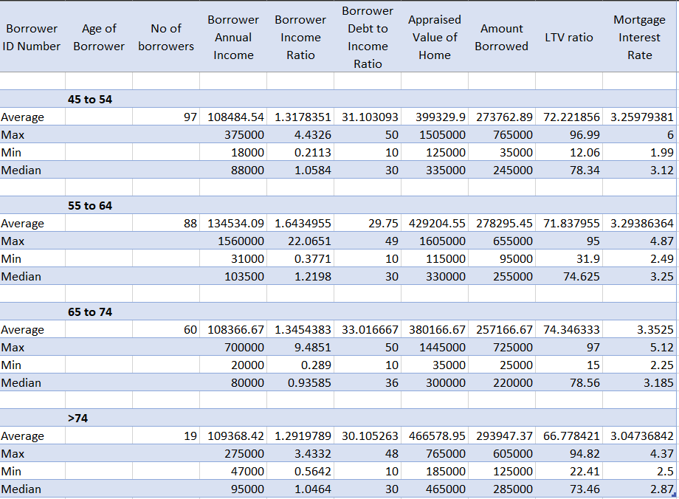
Age-wise distribution: Part 2

Slide 8
Age-wise distribution:

Slide 9
Observations and Key Insights
The age wise distribution for 1st time buyers and experienced buyers helps us to provide an insight into how to deal with the customer while talking about mortgage agreement.
From the data we can conclude that there are 109 borrowers with their LTV ratio above 80 ; while there are 391 with LTV ratio below or equal to 80.
While we have calculated an average for all the Mortgage and Borrowers data we have made the following observations:
The highest average and highest LTV ratio falls under the age group of 65 – 74 and the lowest is for the age group above 74.
The highest annual income is of people below 25 and also their income ratio is highest.
The age range between 65 – 74 are the people willing to take higher risk for the mortgage.

Slide 10
Insights:
Following are the insights that we can refer to for the choice and consider to approach our customers:
The borrowers below the age of 25 are high earning people but also have the high risk factor as also most of them are first time borrowers it is suitable to approach them with more detail orientation.
The people above the age of 65 also seem to have somewhat similar conditions ; but as the age group gets elder the borrowers are more prone to be experienced in the field and are playing on the safe side.
The density in Wide area code helps us to encounter which area is in high demand among the investors and hence even with high risk factor people decide to go for the particular area.

